Slide 1

CONCEPT
HOW IT WORKS
hardware
AIRAI COMPONENTS
NAVIGATING THE FUTURE: VISUAL NAVIGATION SMALL UAWs
software
AIRAI LOCATION DETERMINATION
SOLUTION TO THE PROBLEM
THE POSSIBILITY OF RETRAINING FOR NEW OPPORTUNITIES
FLYING MAP CREATOR
ARTIFICIAL INTELLIGENCE SOFTWARE TRAINING
DATASET CREATOR

Slide 2
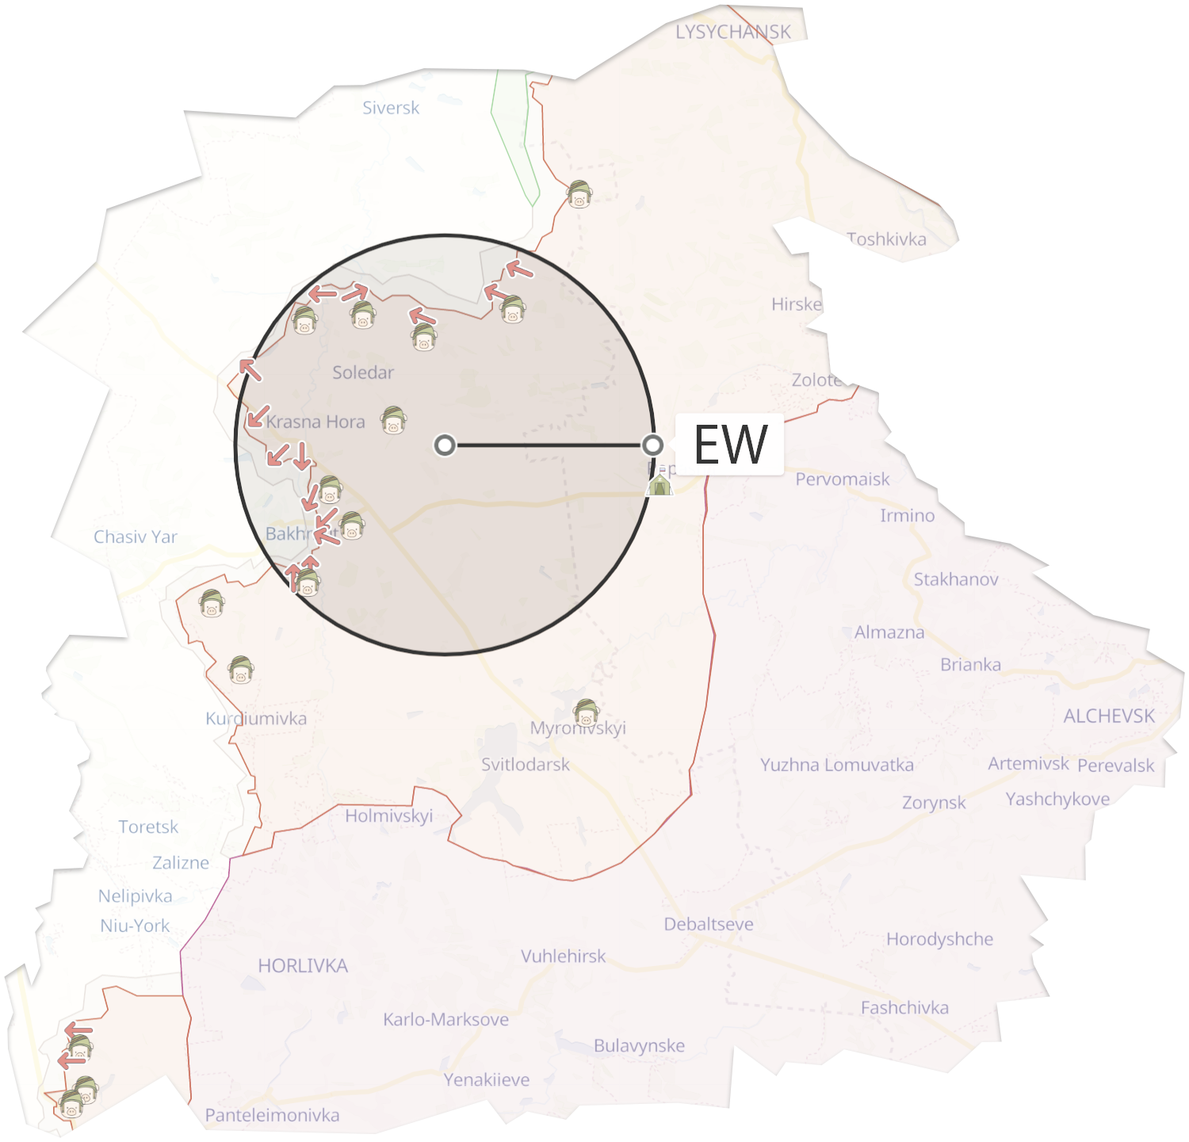



CONCEPT
HOW IT WORKS
Drone preloads satellite map N x N before takeoff
While the drone is flying - takes a photo of the terrain over which it flies does every 0.3-1.5 seconds
Each photo sends to a neuron
Neuron finds the most similar from the database of pre-saved photos
Each photo is linked to the geocodes from which the drone receives the GPS coordinates
MIN OPERATIONAL AWARENESS TIME
20
METERS ON PIXELS
Picture resolution from 0.5 and below
0.5

